Slide 1
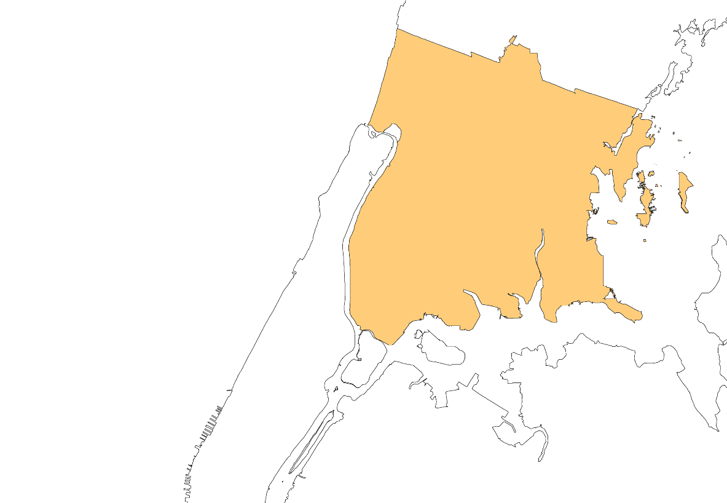











#Not62:
The Campaign for a Healthy Bronx
5-Year Community Campaign
Action Plan C – Version 4.0
Updated July 2026

Slide 2
Table of Contents
3 Introduction
#Not62 Origin Story
Accomplishments
Action Plan Purpose
10 Action Plan Overview
Glossary
Goal
Process Map
Action Steps
21 Strategies & Tactics
Strategies
Action Areas
Tactics and Campaign Timeline
42 Addenda
A – Stakeholder Map B – Pledge Form
C – Contact List D – Organization Structure
#Not62 Community Campaign Action Plan

Slide 3
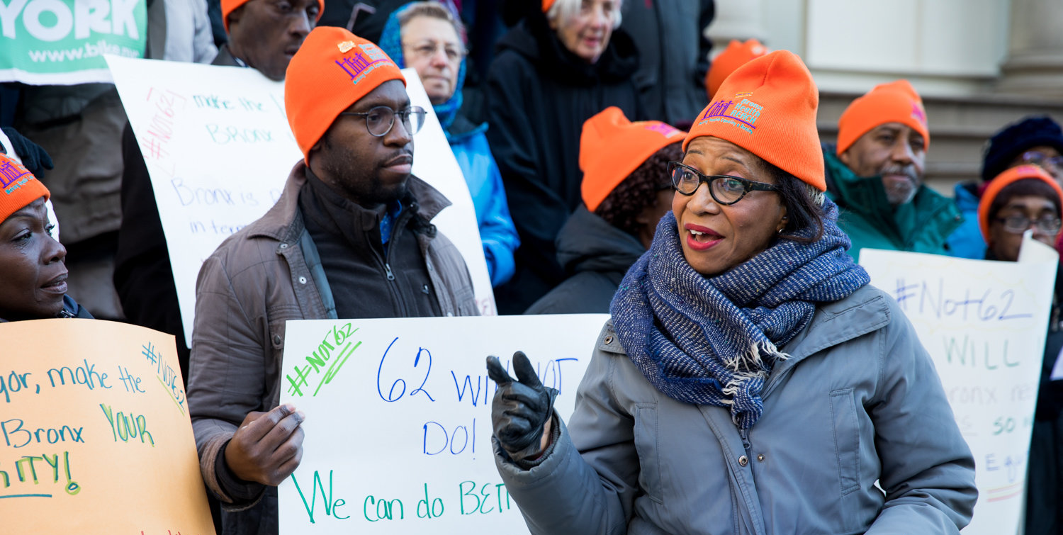
Introduction
3
#Not62 Community Campaign Action Plan

Slide 4
#Not62 Origin Story
County Health Rankings
In 2009, the Robert Wood Johnson Foundation began ranking every state’s counties on health outcomes and health factors; the Bronx ranked 62nd of New York’s 62 counties in every edition. RWJF retired the rankings in 2024 in favor of national Health Groups, so the Bronx no longer carries a numbered rank — but it still fares worse than the average New York State county on both measures.
The Campaign for a Healthy Bronx
In response to the Bronx’s consistently low health ranking, several groups came together in 2014 and launched #Not62 - The Campaign for a Healthy Bronx. Through collaboration between Bronx residents, businesses, health care providers, community organizations, and elected officials, the #Not62 Campaign was formed to change the conversation about health in the Bronx and to serve as a key catalyst for partners across sectors to take action in improving the health of Bronx residents.
The Campaign hosted a series of initiatives that coincided with improvements in several health outcomes – Bronx residents were spending less time in hospitals, were living longer, and living healthier and more active lifestyles. However, in 2020, that progress was devastated with the arrival of the COVID-19 pandemic, which exacerbated existing conditions in the Bronx. Now more than ever, the #Not62 Campaign is committed to addressing the many interconnected factors that impact a person’s wellbeing so that everyone in the borough can attain their highest level of health and live longer.
Steering Committee
The #Not62 Campaign for a Healthy Bronx is led by a steering committee composed of the Bronx Borough President’s Office, Institute for Family Health/Bronx Health REACH, Montefiore Health System, Essen Health Care, Lincoln Hospital, St Barnabas Hospital, CUNY (Lehman & Hostos), FBOs, CBOs and the NYC Department of Health and Mental Hygiene’s Bronx Neighborhood Health Action Center.
4 - Introduction
#Not62 Community Campaign Action Plan

Slide 5
Accomplishments
2014
2015
Food and Health Behaviors
2016
Food and Health Behaviors
2017
Food and Health Behaviors, Mental Health
Founding of #Not62 - The Campaign for a Healthy Bronx
Releases #Not62 Campaign PSA videos
Convenes the Annual Health Summit
Promotes Bronx Week - Bronx Health Day with the Bronx Borough President’s Office
Promotes Bronx Healthy Food Week with DOH
Receives the RWJF Culture of Health Prize Award
#Not62 holds a Town Hall on the Campaign for a Healthy Bronx
Participates in iHeal Bronx Active Living Week with DOH
Launches the Rethink Your Drink program with Montefiore and the Healthy Beverage Zone Project with DOHMH, UCHC, and Bronx Health REACH
Launches the Eat Smart Month PSA Campaign with American Heart Association, Shop Healthy NYC, and the Healthy Beverage Zone
Launches the Bronx Emotional Wellness Project
Launches the Bronx Bodega Partners “Don’t Stress Eat Fresh” Workgroup
5 - Introduction
#Not62 Community Campaign Action Plan

Slide 6
Accomplishments
2018
Food and Health Behaviors, Mental Health
2019
Health Behaviors, Mental Health
2020
Food and Health Behaviors, Health Care
2021
Mental Health
Expands the Healthy Beverage Zone
Bronx Health REACH rallies for the Bronx to be #Not62
Hosts the Bronx Emotional Wellness and Unique People Services Resiliency Panel
Calls for the Bronx Borough President to establish a Health Committee Director
Hosts Boogie on the Boulevard
Hosts the Opioid Addiction Round Table with Bronx Elected Officials and City Agencies
Launches the “Don’t Stress Eat Fresh” Healthy Food Marketing Campaign
Co-presents the “Health Disparities and COVID19 in the Bronx” Panel
Hosts the Bronx Food Justice Forum
Contributes to passing a bill sponsored by Senator Kamala Harris and Representative Lauren Underwood: Black Maternal Health Momnibus Act of 2020
Celebrates #Not62 Campaign’s 5th Anniversary
Participates in Bronx Week Health Day
Participates in Mental Health Marketplace
6 - Introduction
#Not62 Community Campaign Action Plan

Slide 7
Accomplishments
2022
Food and Health Behaviors, Mental Health
2023
Food and Health Behaviors, Mental Health
2024
Food and Health Behaviors, Mental Health
2025
Food and Health Behaviors, Mental Health
Participates in Bronx Week Health Day
Continues to participate in Mental Health Marketplace
Approval and Adoption of the updated Campaign’s Policy & Procedure
Transition of DOHMH Facilitator
#Not62 Coalition Self-Assessment and Findings
Prioritized 3- Action Areas - Healthy Food Access, Mental Health, Workforce and Economic Development
Appointment of DOHMH #Not62 facilitator.
County Health Ranking & Roadmaps presentation of Data Summary to Steering Committee and stakeholders
Activation of Healthy Food Access and Mental Health Subcommittees with projected biweekly meeting for the 4th Quarter.
New Timeline for capacity building.
Press Releases on proposed Food Policies
Press Releases on proposed Mental Health Policies
Engage elected officials to buy into the proposed policies.
Participates in Bronx Week Health Day
Power Mapping & Structural Determinants Session
7 - Introduction
#Not62 Community Campaign Action Plan

Slide 8
Accomplishments
2026
Food and Health Behaviors, Mental Health
2027
Governance and Community Engagement
2028
All Five Action Areas
2029
All Five Action Areas
Participates in Bronx Week Health Day
Continues to participate in Mental Health Marketplace
Collaboration with other Bronx Health related Coalitions
Plan a Legislative Health Summit to build support for the proposed policies
Re-alignment of #Not62 goals and objectives with the administration’s health agenda
Expand the Steering Committee
Engage community through borough-wide listening sessions
Launch subcommittee workplans for each Action Area
Amplify partner initiatives across all five Action Areas
Open a second partner recruitment cycle
Mid-point review of Action Plan progress
Refresh subcommittee membership and workplans
Renew the community engagement cycle
Publish a progress report against Action Plan objectives
8 - Introduction
#Not62 Community Campaign Action Plan

Slide 9
Action Plan Purpose
The #Not62 Steering Committee is committed to fundamentally changing the conversation around improving the health and wellbeing of Bronx residents.
This revised Action Plan serves as a strategic planning tool to guide the steering committee in leading #Not62 Campaign efforts over the next five years. The Plan provides a framework for organizing internal processes and tracking the Campaign’s progress on strategies, actions, and benchmarks that will advance its public-facing agenda and help the committee build out a robust multi-sector coalition of campaign partners.
9 - Introduction
#Not62 Community Campaign Action Plan

Slide 10
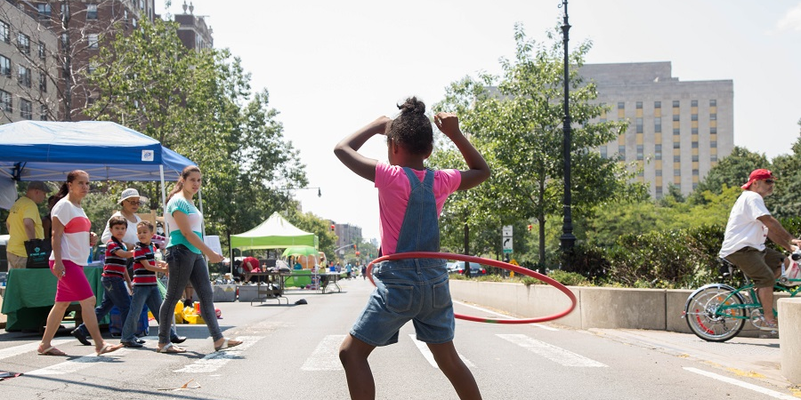
Action Plan Overview
10 - Action Plan Overview
#Not62 Community Campaign Action Plan

Slide 11
Glossary
Action Areas Priority areas for the #Not62 Campaign to achieve its Goals. Objectives are developed with regard to Action Areas.
Process A series of actions or steps led by the steering committee and partners to achieve particular outcomes.
Goals Broad vision statement for the #Not62 Campaign.
Objectives Outcomes that lead to the realization of the Goal, which can be tracked and measured.
Strategies Coherent collection of actions with a reasonable chance of achieving the desired Objectives.
Tactics Specific actions that operationalize the Strategies.
Partners Stakeholders and organizations in the Bronx that will drive the implementation of Tactics.
Metrics Measurable indicators that will track the #Not62 Campaign’s success in achieving their Objectives.
11 - Action Plan Overview
#Not62 Community Campaign Action Plan

Slide 12
Goal
Fundamental racial and socioeconomic inequities have disproportionately barred Bronx residents from attaining their highest level of health. As a result, the Bronx is ranked as the least healthy of New York’s 62 counties.
The #Not62 Campaign for a Healthy Bronx is a community-driven approach to improving the overall health and wellness of Bronx residents by building awareness and partnerships.
12 - Action Plan Overview
#Not62 Community Campaign Action Plan

Slide 13
#Not62 Process Map
 | Internal Infrastructure - Ongoing | Internal Infrastructure |  | Leads | Public Engagement | Timeframe
Phase 1 | Internal Infrastructure focuses on building the in-house capacity of the steering committee to lead and build a successful Campaign. This internal-facing work is about “setting up shop”, recruiting key partners, activating subcommittees that engage active stakeholders, and building up its leadership. |  |  |  | Public Engagement refers to work that is public-facing, mobilizing community partners/stakeholders to identify priorities for #Not62 and initiate policies and advocacy activities recommended by Action Area subcommittees (e.g. Healthy Food Access, Mental Health, Workforce + Economic Development).
Actions | Set Up Shop | Recruit Partners | Activate Sub Committees | Steering Committee | Engage Community to Identify Priorities for #Not62 | Amplify Partner Initiatives
Definition | Steering Committee gets organized and “staffed” to implement Action Plan; make decisions on committee structure. | Key individuals are identified and recruited for their expertise in the campaign’s Action Areas to join the Subcommittee. | Action Area Sub-committee(s) are co-led by Steering committee member and recruited partners. They will meet regularly to determine priorities and recommend actions | Partners who have been working closely with Steering Committee on advancing Not62 agenda in Action Areas get invited to serve on Campaign’s leadership committee | Various community partners/stakeholders are invited to join regular committee/council meetings to help inform and shape policy/advocacy recommendations; They are your boots on the ground for mobilizing public engagements for the #Not62 Campaigns. | Actions that build a highly visible and influential #Not62 Campaign that leads to policy changes and holds Bronx decision-makers accountable to residents
13 - Action Plan Overview
#Not62 Community Campaign Action Plan

Slide 14
#Not62 Process Map
 | Internal Infrastructure | Internal Infrastructure |  | Leads | Public Engagement |  | Timeframe
Actions | Set Up Shop | Steering Committee | Activate Committees | Steering Committee Membership | Engage Community to Identify Priorities for #Not62 |  | Amplify Partner Initiatives
Objectives | Build the #Not62 Campaign’s capacity to grow | Deepen expertise and build stronger co-leadership | Build a leadership & partnership pipeline to build the Steering Committee's power base | Review campaign clout, visibility, and impact across sectors in the Bronx | Establish co-leadership with credible Focus Area experts as #Not62 Partners | Engage and activate community stakeholders who mobilize for and support the Not62 Campaign agenda | Increase the level of #Not62 Campaign Activity co-led/informed by larger base of Partners and community stakeholders
Metrics | Action Plan that prioritizes Healthy Food, Mental Health and Workforce Action Areas | Commitment from Steering committee members to co-lead Focus Area sub-committees | Active sub-committees meet 6 -12 times a year 5 actions recommended for each Action Area that support key priorities | Replacement of inactive Steering Committee member with designated person or with a new and vibrant #Not62 Partners | List of priorities for each Action Areas | Renewed Pledges from 10-15 community organizations | 1-2 #Not62 Public Activities and Initiatives per year
14 - Action Plan Overview
#Not62 Community Campaign Action Plan

Slide 15
Action Step: Internal Infrastructure
Set Up Shop
Objective: Build the #Not62 Campaign’s capacity to grow
 | Actions | Actions | Leads | Timeframe
1.1 | Review Action Plan as a Steering Committee to reconfirm Timeline; Steering Committee Roles/Assignments; Subcommittee expectations; recruitment strategy | Review Action Plan as a Steering Committee to reconfirm Timeline; SC Roles/Assignments; Subcommittee expectations; recruitment strategy | Steering Committee | 2024 – Q3 + Q4
1.2 | Determine as a steering committee whether implementation of this Action Plan will require dedicated staff time to achieve. And if so, modify Action Plan to include steps to secure funding for this hire. | Set up meetings with potential funders (RWJ, BBP, etc.) to present Action Plan and secure grant funding for Not62 | Steering Committee | 2024 – Q2 – Q4
1.3 | Plan for formation of 3 priority Action Area Subcommittees (to start meeting once Co-lead Partners are recruited) | Plan for formation of 3 priority Action Area Subcommittees (to start meeting once Co-lead Partners are recruited) | Steering Committee | 2024 – Q2 – Q4
1.3.1 | 1.31 | Healthy Food Access, Food Security, Nutrition, and Healthy Behaviors | Liz, Monsignor Sakano, Dr. Bola
1.3.2 |  | Mental Health, Community Wellbeing, Resiliency, and Preparedness | Fabian, Dr. Roldos, Dr Bola
1.3.3 |  | Workforce + Economic Development | Charmaine, Melissa, Dr. Bola
15 - Action Plan Overview
#Not62 Community Campaign Action Plan

Slide 16
Action Step: Internal Infrastructure
Recruit Partners
Objective: Deepen expertise and build stronger co-leadership
 | Actions | Leads | Timeframe
2.1 | Identify 3 lead advocates/community partners best suited to co-lead and/or serve on one of 3 Not62 Action Area Sub-committees | Steering Committee | 2024 – Q2 – Q3
2.2 | Set up recruitment meetings with prospective Action Area partners who will serve as sub-committee co-leads | Subcommittee Co-Leads | 2024 – Q4
2.3 | Introduce Not62 Vision, Action Plan and initial SC-generated objectives to these lead advocates/prospective committee partners | Subcommittee Co-Leads | 2024 – Q4
2.4 | Secure their commitment to join as a Not62 Partner (see pledge) and serve on a sub-committee (sign pledge forms and attend Sub-Committee meetings) | Subcommittee Co-Leads | 2024 – end of Q4 (December)
16 - Action Plan Overview
#Not62 Community Campaign Action Plan

Slide 17
Action Step: Internal Infrastructure
Activate Subcommittees
Objective: Build a leadership & partnership pipeline for the Steering Committee
 | Actions | Leads | Timeframe
3.1 | Begin regular Subcommittee meetings co-led with recruited credible experts as Not62 partners - to begin ground-truth Goals + Objectives | Steering Committee & new Subcommittee Co-Leads | 2024 – Q3 + Q4
3.2 | Subcommittees set agenda: Identify objectives and key priorities | Subcommittee Co-Leads | 2024 – Q4
3.3 | Identify and recruit committee members who are experts in Action Area agenda | Subcommittee Co-Leads | 2024 – Q4
3.4 | Subcommittees to craft a message that clearly communicates connection between Action Area and health in the Bronx | Subcommittee Co-Leads | 2024 – Q4
3.5 | Identify top 5 recommendations supporting key priorities + objectives for each Action Area | Steering Committee & new Subcommittee Co-Leads | 2025 – Q1 + Q2
3.6 | Meet with Bronx Borough President to introduce Action Plan + key recommendations coming out of each Action Area Subcommittee | Mahnoor + Charmaine | 2025 – Q2
3.7 | Subcommittees meet regularly to design public actions/ engagement that support 5 top recommendations, priorities + objectives for each Action Area | Subcommittee Co-Leads | 2025 – monthly
17 - Action Plan Overview
#Not62 Community Campaign Action Plan

Slide 18
Action Step: Internal Infrastructure
Expand Steering Committee
Objective: Expand campaign clout, visibility, and impact across sectors in the Bronx
 | Actions | Leads | Timeframe
4.1 | Invite Co-lead Subcommittee Partners to attend quarterly Steering Committee to report (together w/ SC co-lead) on Subcommittee priorities + progress | Dr. Bola | 2025 – Q1 bi-monthly
4.2 | Check status of funding opportunities | Anita | 2025 – Q1
4.3 | Invite Co-lead Sub-Committee Partners to join the Steering Committee | Steering Committee | 2025 – Q4
4.4 | Public recognition (e.g. at an engagement event) of expanded Not62 Partnership (SC) and all other partners (represented in Sub-Committees) | Steering Committee | 2026 – Q1 – Q4 (at the 2-year mark since relaunching Action Plan)
18 - Action Plan Overview
#Not62 Community Campaign Action Plan

Slide 19
Action Step: Public Engagement
Engage Community to Identify Priorities for #Not62
Objective: Mobilize Bronx residents and leaders to advance the #Not62 Campaign goals
 | Actions | Leads | Timeframe
5.1 | Work within subcommittees to identify opportunities for #Not62 public engagements and actions in each of the 3 priority Action Areas | Steering Committee & new Subcommittee Co-Leads | 2025 – Q1
5.2 | Plan for public engagements and actions - identify key partners | Steering Committee & new Subcommittee Co-Leads | 2025 – Q1 + Q2
5.3 | Hold public engagements with Bronx Residents to inform subcommittee priorities & recommendations | Subcommittee Co-Leads | 2025 – Q3
5.4 | Hold public engagement(s) to share back "What we heard" | Subcommittee Co-Leads | 2025 – Q3
5.5 | Plan out a public engagement schedule/calendar for the following year that is discussed/endorsed within each Action Areas Sub-Committee | Subcommittee Co-Leads | 2025 – Q3 + Q4
5.6 | Recruit subcommittee partners (pledge forms) to join #Not62 Campaign as official partners | Subcommittee Co-Leads | 2025 – Q4
19 - Action Plan Overview
#Not62 Community Campaign Action Plan

Slide 20
Action Step: Public Engagement
Amplify Partner Initiatives
Objective: Advance #Not62 Campaign’s policy recommendations to improve Bronx county health ranking
 | Actions | Leads | Timeframe
6.1 | Hold Public engagements with Bronx Elected Officials on policy recommendations coming out of the community |  | 2026 – Q1-Q4
6.2 | Hold public engagement(s) or action(s) that reflect recommendations generated by Action Area subcommittees |  | 2026 - Q1 + Q2 + Q3 + Q4
6.3 | Collect pledges for new, additional Not62 Partner at each of these public engagements |  | Ongoing
6.4 | Launch an annual #Not62 Campaign for a Healthy Bronx “Progress Report” |  | 2026 – Q1- Q4 (February)
20 - Action Plan Overview
#Not62 Community Campaign Action Plan

Slide 21
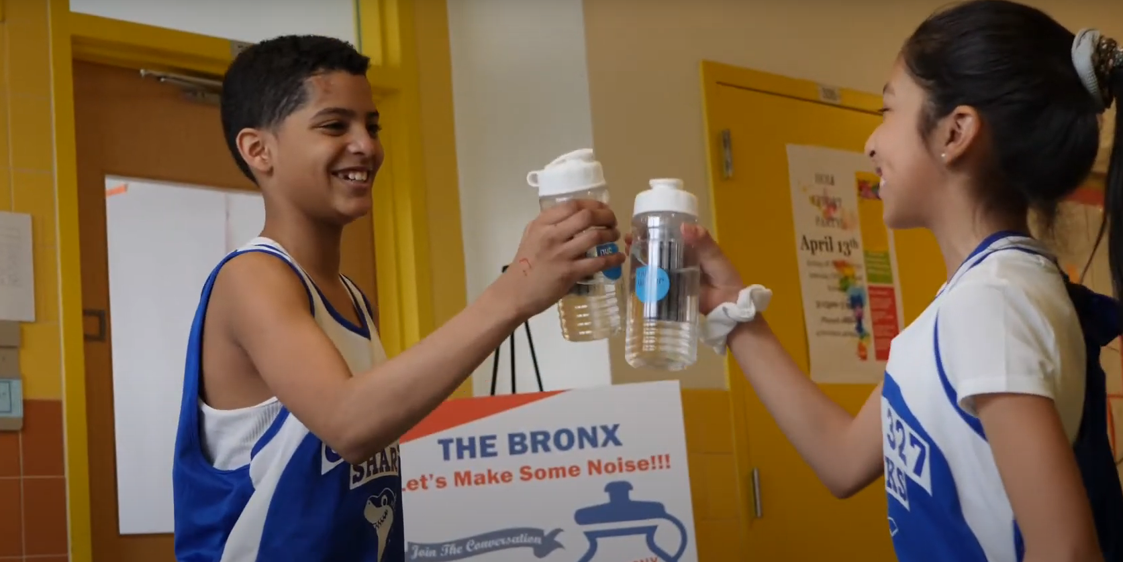
Strategies & Tactics
21
#Not62 Community Campaign Action Plan

Slide 22


Strategies
The #Not62 approach is holistic and cross-sectional. Health equity for #Not62 is not just about healthcare access and public health policy. It is fundamentally about improving the quality of life - the health and wellness - of Bronx residents. To do this, The #Not62 Campaign considers all aspects of life and addresses the inequities within housing, jobs, food security, mental health, and healthcare that directly impact residents’ health.
To achieve this, the #Not62 Campaign will employ the following two strategies:
Shifting Paradigms
Making Connections
22 - Strategies & Tactics
#Not62 Community Campaign Action Plan

Slide 23
Shifting Paradigms
The #Not62 Campaign clearly communicates that the Bronx is the least healthy county in New York State, an effective hook and first step in confronting the health disparities Bronx residents face.
The #Not62 Campaign changes the conversation around health in the Bronx.
  The Bronx has to do things differently. Health in the Bronx must be prioritized, which can only happen if everybody recognizes their responsibility for the health of the borough, for the residents.
  #Not62 shows how everyone has a role to play in making the Bronx healthier, from individuals, to medical institutions, faith-based organizations, businesses, elected officials, and municipal bodies.
Making Connections
The #Not62 Campaign facilitates connections and collaborates with multi-sector partners to address the most pressing health disparities impacting Bronx residents.
The #Not62 Campaign is an information conduit between partners across sectors.
The #Not62 Campaign is a key catalyst of actions taken by partners that improve the health of Bronx residents
23 - Strategies & Tactics
#Not62 Community Campaign Action Plan

Slide 24





Action Areas
The #Not62 Campaign is committed to tackling health inequities across multiple sectors. For the next five years, #Not62 will focus on the following action areas, which encompass the most urgent and important challenges Bronx residents face in attaining their highest levels of health.
  Healthy Food Access, Food Security, Nutrition, and Healthy Behaviors
  Mental Health, Community Wellbeing, Resiliency, and Preparedness
  Workforce and Economic Development
  Health Care Access
  Built Environments and Housing Quality
24 - Strategies & Tactics
#Not62 Community Campaign Action Plan

Slide 25
  Healthy Food Access, Food Security, Nutrition, and Healthy Behaviors (1 of 3)
Objectives | Tactics | Partners | Metrics
Build awareness around what food insecurity means for Bronx residents and how it impacts overall health in the Bronx. Promote healthy food and lifestyle choices and daily physical activity. Increase access to healthy and affordable food. Reduce food insecurity. | Strategy: Shifting Paradigms Conduct targeted outreach to Bronx residents, businesses, and institutions. Craft targeted messaging to increase the health literacy of Bronx residents, enabling them to make more informed health-related behavioral choices and decisions for themselves and others. Develop targeted marketing for SNAP enrollment and the use of SNAP benefits on healthy foods. Strategy: Making Connections Continue to work with local bodegas to increase access to healthy, affordable foods. Work with schools to promote educational programs that promote healthy food and beverage choices. Promote policies to de-incentivize unhealthy beverages and foods (e.g., sugary beverage tax, promote water consumption). Work with local employers to promote healthy food and beverage choices among employees. | Education Business and Business Organizations Community-Based Service Providers (Emergency Food Providers) Parks and Recreation | Number of people reached through outreach campaign Number of new pledge cards signed Engagement with messaging materials Number of bodegas and other businesses that displayed messaging materials Annual tracking/reporting: Household food insecurity Rates of obesity Rates of diabetes Rates of physical inactivity
25 - Strategies & Tactics
#Not62 Community Campaign Action Plan

Slide 26
  Healthy Food Access, Food Security, Nutrition, and Healthy Behaviors (2 of 3)
Process | Actions | Leads | Timeframe
Recruit Partners | Identify lead advocates or community partners best suited to co-lead or serve on the Healthy Food Access, Food Security, Nutrition, and Healthy Behaviors Subcommittee | Liz, Monsignor Sakano, Dr. Bola | 2024 – Q3 + Q4
 | Set up recruitment meetings with prospective Action Area partners and/or co-leads to introduce the #Not62 vision, action plan, objectives, and secure their commitment to join as a partner by signing the Pledge Form | Liz, Monsignor Sakano, Dr. Bola | 2024 – Q3 + Q4
Activate Subcommittee | Identify objectives, set key priorities, and determine tactics to achieve objectives | Liz, Monsignor Sakano, Dr. Bola & new Co-Leads | 2024 – Q4
 | Identify and recruit committee members who are experts in Action Area agenda | Liz, Monsignor Sakano, Dr. Bola & new Co-Leads | 2024 – Q4
 | Craft a message that clearly communicates connection between healthy food access, food security, nutrition, healthy behaviors and health in the Bronx | Liz, Monsignor Sakano, Dr. Bola & new Co-Leads | 2024 – Q4
 | Share top 5 objectives and supporting tactics for Healthy Food Access, Food Security, Nutrition, and Healthy Behaviors with the #Not62 Steering Committee | Liz, Monsignor Sakano, Dr. Bola & new Co-Leads | 2025 – Q1 + Q2
 | Meet regularly to design public actions/engagement that supports the top recommendations, priorities, and objectives for each Action Area | Liz, Monsignor Sakano, Dr. Bola & new Co-Leads | 2025 – monthly
26 - Strategies & Tactics
#Not62 Community Campaign Action Plan

Slide 27
  Healthy Food Access, Food Security, Nutrition, and Healthy Behaviors (3 of 3)
Process | Actions | Leads | Timeframe
Engage Community | Identify opportunities for engagement and implementation of tactics | Liz, Monsignor Sakano, Dr. Bola & new Co-Leads | 2025 – ongoing
 | Identify key partners and plan for public engagement | Liz, Monsignor Sakano, Dr. Bola & new Co-Leads | 2025 – Q1
 | Hold public engagements with Bronx residents to inform subcommittee messaging, objectives, priorities, and tactics | Liz, Monsignor Sakano, Dr. Bola & new Co-Leads | 2025 – Q2 + Q3
 | Synthesize and summarize findings from engagement and share back “what we heard” | Liz, Monsignor Sakano, Dr. Bola & new Co-Leads | 2025 – Q4
 | Discuss and endorse public engagement schedule for the following year | Liz, Monsignor Sakano, Dr. Bola & new Co-Leads | 2025 – Q4
Amplify Partner Initiatives | Hold public engagement(s) or action(s) that reflect recommendations and findings from community engagement | Liz, Monsignor Sakano, Dr. Bola & new Co-Leads | 2026 – Q1 + Q2 + Q3
 | Collect pledges for new, additional Not62 Partner at each of these public engagements | Liz, Monsignor Sakano, Dr. Bola & new Co-Leads | Ongoing
27 - Strategies & Tactics
#Not62 Community Campaign Action Plan

Slide 28
Mental Health, Community Wellbeing, Resiliency, and Preparedness (1 of 3)
Objectives | Tactics | Partners | Metrics
Strengthen community health resiliency to promote flourishing. Advance physical, emotional, and social well-being throughout the Bronx. Raise awareness about the mental health challenges present in the community. Promote a healing-centered approach to mental health care. | Strategy: Shifting Paradigms Conduct targeted outreach to communities of care in the Bronx. Craft targeted messaging that clearly communicates the connection between social cohesion, mental health and physical health outcomes in the Bronx. Raise awareness of mental health challenges and destigmatize conversations around mental health. Work with community based centers, faith based institutions and credible culturally sensitive messengers to educate residents on existing services/resources. Strategy: Making Connections Amplify and strengthen the care work stakeholders do in the Bronx; foster the creation of communities of care Develop and advocate for policy from the perspective of communities of care Encourage and enable Bronx residents to create self-healing community models Work with hospitals and healthcare providers to conduct mental health screenings on all patients. | Faith Based Institutions Community Based Service Providers Education Institutions Parks and Recreation Mental Health Providers Businesses | Number of people reached through outreach campaign Number of new pledge cards signed Engagement with messaging materials Number of credible messengers engaged Annual tracking/reporting: Adults reporting that their neighbors are willing to help one another Rates of substance abuse Reported rates of mental health Rates of Violence
28 - Strategies & Tactics
#Not62 Community Campaign Action Plan

Slide 29
Mental Health, Community Wellbeing, Resiliency, and Preparedness (2 of 3)
Process | Actions | Leads | Timeframe
Recruit Partners | Identify lead advocates or community partners best suited to co-lead or serve on the Mental Health, Community Wellbeing, Resiliency, and Preparedness Subcommittee | Fabian, Dr. Roldos, Dr Bola | 2024 – Q2
 | Set up recruitment meetings with prospective Action Area partners and/or co-leads to introduce the #Not62 vision, action plan, objectives, and secure their commitment to join as a partner by signing the Pledge Form | Fabian, Dr. Roldos, Dr Bola | 2024 – Q3
Activate Subcommittee | Identify objectives, set key priorities, and determine tactics to achieve objectives | Fabian, Drs Roldos/ Bola & new Co-Leads | 2024 – Q4
 | Identify and recruit committee members who are experts in Action Area agenda | Fabian, Drs Roldos/ Bola & new Co-Leads | 2024 – Q4
 | Craft a message that clearly communicates connection between healthy food access, food security, nutrition, healthy behaviors and health in the Bronx | Fabian, Drs Roldos/ Bola & new Co-Leads | 2024 – Q4
 | Share top 5 objectives and supporting tactics for Mental Health, Community Wellbeing, Resiliency, and Preparedness with the #Not62 Steering Committee | Fabian, Drs Roldos/ Bola & new Co-Leads | 2025 – Q1 + Q2
 | Meet regularly to design public actions/engagement that supports the top recommendations, priorities, and objectives for each Action Area | Fabian, Drs Roldos/ Bola & new Co-Leads | 2025 – monthly
29 - Strategies & Tactics
#Not62 Community Campaign Action Plan

Slide 30
Mental Health, Community Wellbeing, Resiliency, and Preparedness (3 of 3)
Process | Actions | Leads | Timeframe
Engage Community | Identify opportunities for engagement and implementation of tactics | Fabian, Father David, Drs Roldos/ Bola & new Co-Leads | 2025 – ongoing
 | Identify key partners and plan for public engagement | Fabian, Father David, Drs Roldos/ Bola & new Co-Leads | 2025 – Q1
 | Hold public engagements with Bronx residents to inform subcommittee messaging, objectives, priorities, and tactics | Fabian, Father David, Drs Roldos/ Bola & new Co-Leads | 2025 – Q2 + Q3
 | Synthesize and summarize findings from engagement and share back “what we heard” | Fabian, Father David, Drs Roldos/ Bola & new Co-Leads | 2025 – Q4
 | Discuss and endorse public engagement schedule for the following year | Fabian, Father David, Drs Roldos/ Bola & new Co-Leads | 2025 – Q4
Amplify Partner Initiatives | Hold public engagement(s) or action(s) that reflect recommendations and findings from community engagement | Fabian, Father David, Drs Roldos/ Bola & new Co-Leads | 2026 – Q1 + Q2 + Q3
 | Collect pledges for new, additional Not62 Partner at each of these public engagements | Fabian, Father David, Drs Roldos/ Bola & new Co-Leads | Ongoing
30 - Strategies & Tactics
#Not62 Community Campaign Action Plan

Slide 31
Workforce and Economic Development (1 of 3)
Objectives | Tactics | Partners | Metrics
Increase access to stable employment (with living wages and paid sick leave). Promote upward mobility and career pathways for unemployed and underemployed Bronx residents. | Strategy: Shifting Paradigms Conduct targeted outreach to workforce and economic development stakeholders in the Bronx. Craft targeted messaging that clearly communicates the connection between workforce development, economic development, and health in the Bronx. Strategy: Making Connections Encourage elected officials and businesses to engage in business practices that address poverty in the Bronx, embracing their commitment to the community, including buying and hiring local. Work with partners to expand workforce development and STEM education programs for Bronx residents. Work with the city to recognize employers that are aligned with Not62’s holistic vision who offer diverse opportunities and jobs with living wages and paid sick leave. Partner with employers and CBOs offering workforce development and training programs focused on Bronx residents. Leverage state and federal money to build the healthcare workforce. | Businesses & Business Organizations BIDs Financial Institutions/Banks Unions Workforce Development Education | Number of people reached through outreach campaign Number of new pledge cards signed Engagement with messaging materials Number of new workforce development programs supported Amount of money invested in healthcare workforce as a result of #Not62 Quantity of workforce and economic development partners Annual tracking/reporting: Unemployment rate Children in Poverty Rate of Uninsured
31 - Strategies & Tactics
#Not62 Community Campaign Action Plan

Slide 32
Workforce and Economic Development (2 of 3)
Process | Actions | Leads | Timeframe
Recruit Partners | Identify lead advocates or community partners best suited to co-lead or serve on the Workforce and Economic Development Subcommittee | Charmaine, Melissa, Dr. Bola | 2026 – Q3
 | Set up recruitment meetings with prospective Action Area partners and/or co-leads to introduce the #Not62 vision, action plan, objectives, and secure their commitment to join as a partner by signing the Pledge Form | Charmaine, Melissa, Dr Bola | 2026 – Q4
Activate Subcommittee | Identify objectives, set key priorities, and determine tactics to achieve objectives | Charmaine, Melissa, Dr. Bola & new Co-Leads | 2026 – Q4
 | Identify and recruit committee members who are experts in Action Area agenda | Charmaine, Melissa, Dr. Bola & new Co-Leads | 2027 – Q1
 | Craft a message that clearly communicates Workforce and Economic Development in the Bronx | Charmaine, Melissa, Dr. Bola & new Co-Leads | 2027 – Q1
 | Share top 5 objectives and supporting tactics for Workforce and Economic Development with the #Not62 Steering Committee | Charmaine, Melissa, Dr. Bola & new Co-Leads | 2027 – Q1 + Q2
 | Meet regularly to design public actions/engagement that supports the top recommendations, priorities, and objectives for each Action Area | Charmaine, Melissa, Dr. Bola & new Co-Leads | 2027 – monthly
32 - Strategies & Tactics
#Not62 Community Campaign Action Plan

Slide 33
Workforce and Economic Development (3 of 3)
Process | Actions | Leads | Timeframe
Engage Community | Identify opportunities for engagement and implementation of tactics | Charmaine, Melissa, Dr. Bola & new Co-Leads | 2025 – ongoing
 | Identify key partners and plan for public engagement | Charmaine, Melissa, Dr. Bola & new Co-Leads | 2025 – Q2
 | Hold public engagements with Bronx residents to inform subcommittee messaging, objectives, priorities, and tactics | Charmaine, Melissa, Dr. Bola & new Co-Leads | 2025 – Q2 + Q3
 | Synthesize and summarize findings from engagement and share back “what we heard” | Charmaine, Melissa, Dr. Bola & new Co-Leads | 2025 – Q4
 | Discuss and endorse public engagement schedule for the following year | Charmaine, Melissa, Dr. Bola & new Co-Leads | 2025 – Q4
Amplify Partner Initiatives | Hold public engagement(s) or action(s) that reflect recommendations and findings from community engagement | Charmaine, Melissa, Dr. Bola & new Co-Leads | 2026 – Q1 + Q2 + Q3
 | Collect pledges for new, additional Not62 Partner at each of these public engagements | Charmaine, Melissa, Dr. Bola & new Co-Leads | Ongoing
33 - Strategies & Tactics
#Not62 Community Campaign Action Plan

Slide 34
Health Care Access (1 of 3)
Objectives | Tactics | Partners | Metrics
Increase health literacy of Bronx residents. Increase the number of Bronx residents with primary care and who regularly receive preventative services (quality of care). Reduce healthcare costs and increase insurance enrollment (access to care). | Strategy: Shifting Paradigms Conduct targeted outreach to Bronx residents and health care providers. Craft targeted messaging to increase the health literacy of Bronx residents, enabling them to make more informed healthcare-related choices, like scheduling regular preventative services. Strategy: Making Connections Work with municipal institutions to think about their role as public health ambassadors. Work with hospitals to promote and encourage regular wellness check-up visits for families. Work with hospitals to promote and encourage screening for social determinants of health. Convene working groups to make policy recommendations (e.g. to eliminate segregation of care in hospitals and to reduce healthcare costs). Work with hospitals and urgent care centers to promote free clinical test offerings to detect early onset of and prevention of diabetes and obesity cases. Work with hospitals and urgent care centers to create systems for sharing of records and information. | Medical Institutions Insurance Providers Municipal Institutions | Number of people reached through outreach campaign Number of new pledge cards signed Engagement with messaging materials Number of policy recommendations made Number of free clinical tests offered Annual tracking/reporting: Number of health screenings completed Preventable hospital stays Rate of annual wellness visits Black maternal mortality rate Medical out-of-pocket expenditures
34 - Strategies & Tactics
#Not62 Community Campaign Action Plan

Slide 35
Health Care Access (2 of 3)
Process | Actions | Leads | Timeframe
Recruit Partners | Identify lead advocates or community partners best suited to co-lead or serve on the Health Care Access Subcommittee | TBD | 2027 – Q2
 | Set up recruitment meetings with prospective Action Area partners and/or co-leads to introduce the #Not62 vision, action plan, objectives, and secure their commitment to join as a partner by signing the Pledge Form | TBD | 2027 – Q4
Activate Subcommittee | Identify objectives, set key priorities, and determine tactics to achieve objectives | TBD | 2027 – Q1
 | Identify and recruit committee members who are experts in Action Area agenda | TBD | 2027 – Q1
 | Craft a message that clearly communicates connection between healthy food access, food security, nutrition, healthy behaviors and health in the Bronx | TBD | 2027 – Q1
 | Share top 5 objectives and supporting tactics for Health Care Access with the #Not62 Steering Committee | TBD | 2027 – Q2 + Q3
 | Meet regularly to design public actions/engagement that supports the top recommendations, priorities, and objectives for each Action Area | TBD | 2027 – monthly
35 - Strategies & Tactics
#Not62 Community Campaign Action Plan

Slide 36
Health Care Access (3 of 3)
Process | Actions | Leads | Timeframe
Engage Community | Identify opportunities for engagement and implementation of tactics | TBD | 2027 – ongoing
 | Identify key partners and plan for public engagement | TBD | 2027 – Q2
 | Hold public engagements with Bronx residents to inform subcommittee messaging, objectives, priorities, and tactics | TBD | 2027 – Q3 + Q4
 | Synthesize and summarize findings from engagement and share back “what we heard” | TBD | 2028 – Q1
 | Discuss and endorse public engagement schedule for the following year | TBD | 2028 – Q1
Amplify Partner Initiatives | Hold public engagement(s) or action(s) that reflect recommendations and findings from community engagement | TBD | 2028 – Q2 + Q3 + Q4
 | Collect pledges for new, additional Not62 Partner at each of these public engagements | TBD | Ongoing
36 - Strategies & Tactics
#Not62 Community Campaign Action Plan

Slide 37
Built Environments and Housing Quality (1 of 3)
Objectives | Tactics | Partners | Metrics
Improve housing and indoor environmental quality and safety. Promote the development of a cleaner, more healthy outdoor environment.. Promote walkable and bikeable neighborhoods and active use of public spaces. | Strategy: Shifting Paradigms Conduct targeted outreach to affordable housing residents and providers in the Bronx. Craft targeted messaging that clearly communicates the connection between housing quality and indoor environmental quality and health in the Bronx. Strategy: Making Connections Work with Affordable housing providers to deter smoking in public spaces. Work with the city agencies to enforce/incentivize lead tests, pest management and air quality control (e.g. drinking water violations, test air pollution particulate matter). Work with city and insurance providers to cover lead testing in NYCHA housing in the Bronx. Advocate for Integrated Pest Management and Allergen Reduction as a Medicaid-reimbursable activity. Identify and promote exemplary partners that work across agencies to address public safety. (e.g. Transportation + Dept of Sanitation) Work with the city to reroute bus routes and advocate for green electric vehicles. | Affordable Housing Providers Municipal Institutions Insurance Providers Parks and Recreation | Number of people reached through outreach campaign Number of new pledge cards signed Engagement with messaging materials Number of lead tests conducted as a result of outreach Annual tracking/reporting: Rate of severe housing problems Rates of asthma Blood lead level in children 1-5 Air pollution - particulate matter Rate of residents who walk or bike to work
37 - Strategies & Tactics
#Not62 Community Campaign Action Plan

Slide 38
Built Environments and Housing Quality (2 of 3)
Process | Actions | Leads | Timeframe
Recruit Partners | Identify lead advocates or community partners best suited to co-lead or serve on the Built Environments and Housing Quality Subcommittee | TBD | 2026 – Q2
 | Set up recruitment meetings with prospective Action Area partners and/or co-leads to introduce the #Not62 vision, action plan, objectives, and secure their commitment to join as a partner by signing the Pledge Form | TBD | 2026 – Q4
Activate Subcommittee | Identify objectives, set key priorities, and determine tactics to achieve objectives | TBD | 2027 – Q1
 | Identify and recruit committee members who are experts in Action Area agenda | TBD | 2027 – Q1
 | Craft a message that clearly communicates connection between healthy food access, food security, nutrition, healthy behaviors and health in the Bronx | TBD | 2027 – Q1
 | Share top 5 objectives and supporting tactics for Built Environments and Housing Quality with the #Not62 Steering Committee | TBD | 2027 – Q2 + Q3
 | Meet regularly to design public actions/engagement that supports the top recommendations, priorities, and objectives for each Action Area | TBD | 2027 – monthly
38 - Strategies & Tactics
#Not62 Community Campaign Action Plan

Slide 39
Built Environments and Housing Quality (3 of 3)
Process | Actions | Leads | Timeframe
Engage Community | Identify opportunities for engagement and implementation of tactics | TBD | 2027 – ongoing
 | Identify key partners and plan for public engagement | TBD | 2027 – Q2
 | Hold public engagements with Bronx residents to inform subcommittee messaging, objectives, priorities, and tactics | TBD | 2027 – Q3 + Q4
 | Synthesize and summarize findings from engagement and share back “what we heard” | TBD | 2028 – Q1
 | Discuss and endorse public engagement schedule for the following year | TBD | 2028 – Q1
Amplify Partner Initiatives | Hold public engagement(s) or action(s) that reflect recommendations and findings from community engagement | TBD | 2028 – Q2 + Q3 + Q4
 | Collect pledges for new, additional Not62 Partner at each of these public engagements | TBD | Ongoing
39 - Strategies & Tactics
#Not62 Community Campaign Action Plan

Slide 40
#Not62 Campaign Timeline
Healthy Food & Nutrition
Health Care Access
Mental Health & Wellbeing
Built Environments & Housing
Workforce Development
Internal Infrastructure
Public Engagement
1. Set Up Shop
2. Recruit Partners
2. Recruit Partners
3. Activate Subcommittees
3. Activate Subcommittees
4. Expand Steering Committee
4. Expand Steering Committee
5. Engage Community
5. Engage Community
6. Amplify Partner Initiatives
2026
2027
2028
2029
2030
40 - Strategies & Tactics
#Not62 Community Campaign Action Plan

Slide 41
#Not62 Campaign Timeline – Alternative Governance Option
Internal Infrastructure
Public Engagement
1. Set Up Shop
2. Recruit Partners
The Council of Partners is composed of key individuals recruited for their expertise in the campaign’s Action Areas to serve as #Not62’s institutional partners
3. Activate Council of Partners
4. Expand Leadership/Steering Committee
5. Engaging Community
6. Amplify Partner Initiatives
2026
2027
2028
2029
2030
41 - Strategies & Tactics
#Not62 Community Campaign Action Plan

Slide 42
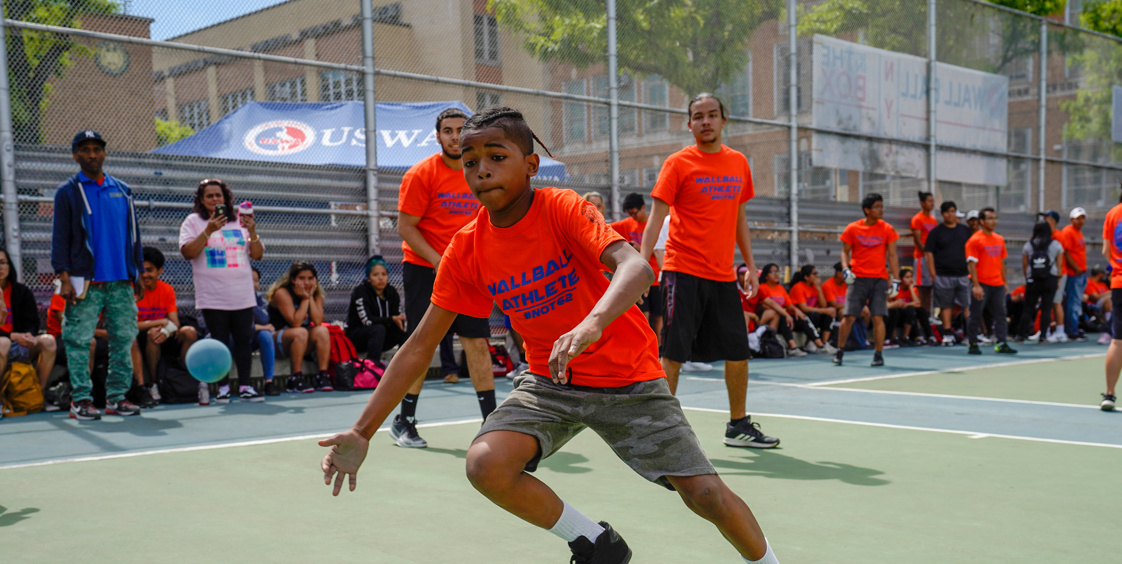
Addenda
42
#Not62 Community Campaign Action Plan

Slide 43
Addenda
Addendum A Stakeholder Map
Addendum B Pledge Form
Addendum C Contact List
Addendum D Organization Structure
#Not62 Community Campaign Action Plan

Slide 44
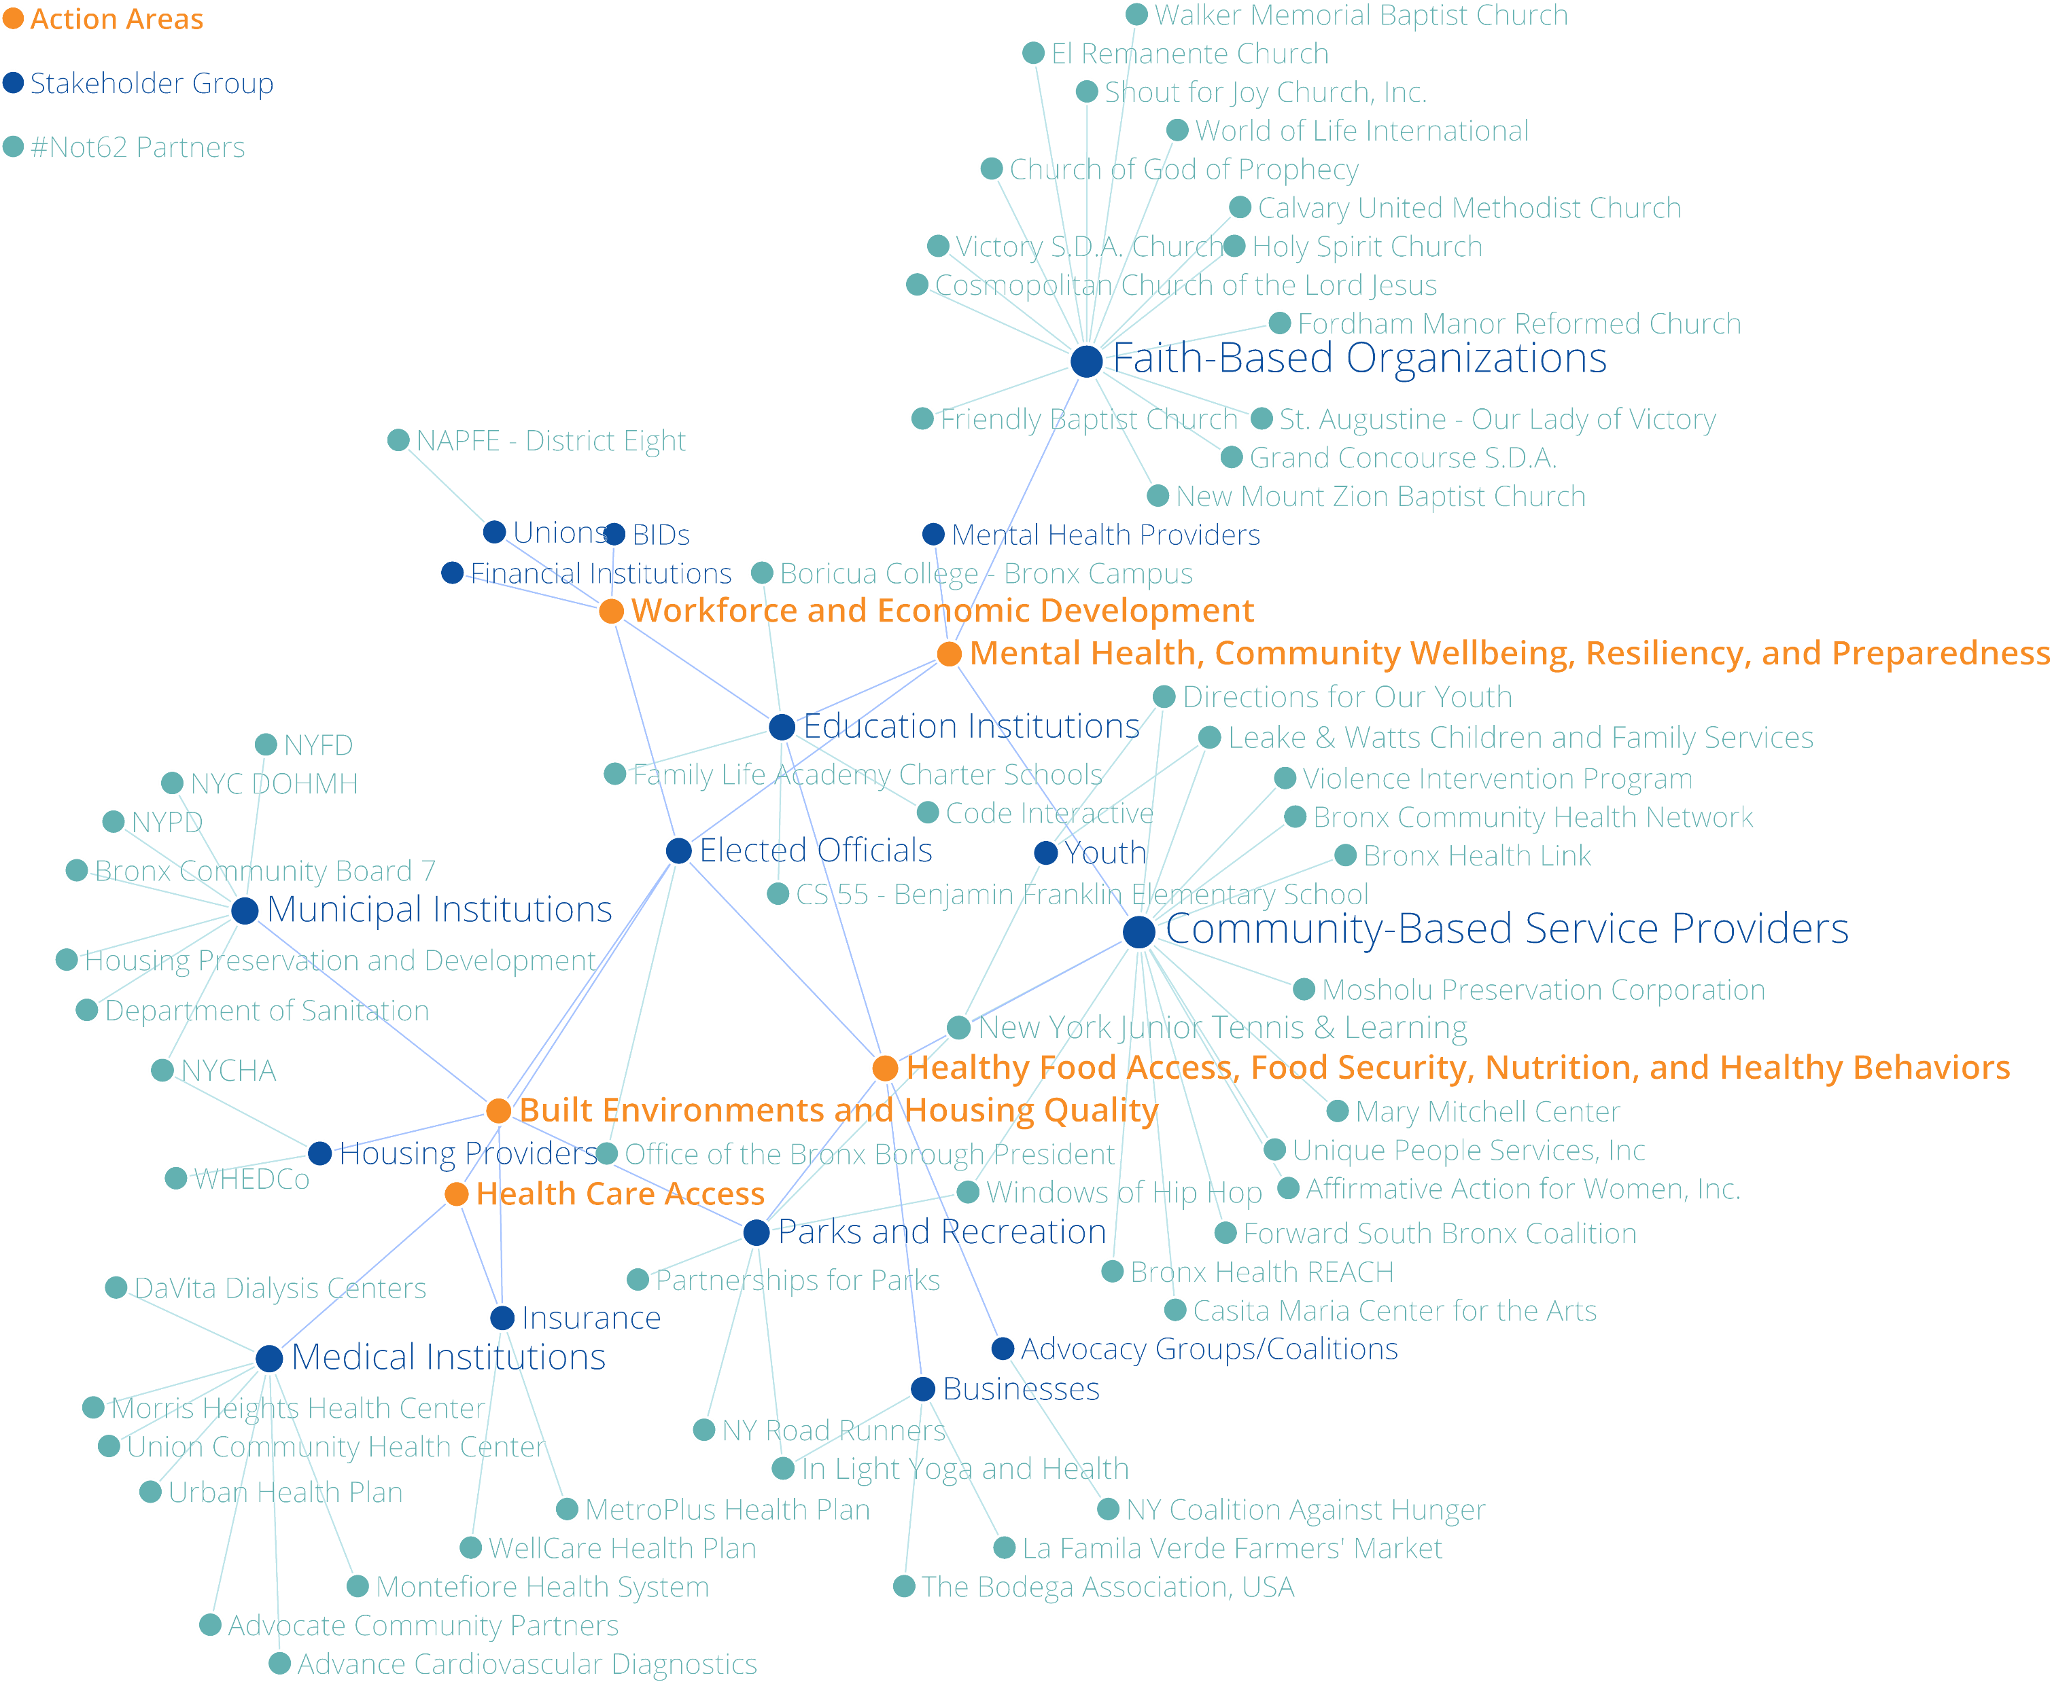
Stakeholder Map
Partnerships are at the core of the #Not62 Campaign’s strategies to improve the health and wellbeing of Bronx residents. The adjacent network map shows the web of community partners that have engaged with #Not62 over the course of the Campaign’s decade-long history. Lines connect these partners into groups and connect those groups to the Action Areas detailed in this Action Plan, showing that there is ample opportunity for partnerships to flourish in support of #Not62’s objectives. The network map also shows where there are needs to build deeper connections with communities, as well. For instance, BIDs and unions, two stakeholder groups that #Not62 is interested in connecting with, have not been as actively engaged to date.
The map was created using information provided by organizations via Pledge Cards. Organizations were then associated with Action Areas as a result of a stakeholder mapping conversation conducted with the #Not62 Steering Committee. When outreach begins, organizations may want to be involved in Action Areas that differ from what is currently shown, and this network map may be updated accordingly.
Overall, this map is a starting point, providing insight into the partners that the #Not62 Campaign is well positioned to re-engage, as well as those partners that should be targeted for more specific, concerted outreach.
View and edit the network map.
44 - Addendum A
#Not62 Community Campaign Action Plan

Slide 45
Pledge Form
The #Not62 Pledge form is an introduction to the #Not62 Campaign. Signing on to a Pledge is a commitment to improving the health and well-being of Bronx residents. When paired with deliberate outreach, targeted messaging, and continued follow-up, the Pledge Form serves a key role in achieving the Objectives of the #Not62 Campaign, as a catalyst towards further involvement and action.
45 - Addendum B
#Not62 Community Campaign Action Plan

Slide 46
Contact List
Core to the strategies of the #Not62 campaign is ongoing, concerted outreach to community organizations and potential partners across the Bronx. The Contact List, constructed using data obtained from Pledge Cards, is the centerpiece of this effort.
View the updated Contact List template, which includes space for the #Not62 Steering Committee to keep track of engagement with partners and coordinate outreach efforts as the Campaign works towards its objectives across five Action Areas, and easily track which organizations are involved in the various subcommittees and actions taken by the #Not62 campaign.
46 - Addendum C
#Not62 Community Campaign Action Plan

Slide 47
Organization Structure
+ Community Partners
Workforce Development
+ Community Partners
Mental Health & Wellbeing
+ Community Partners
#Not62 Steering Committee
Built Environments & Housing
Healthy Food & Nutrition
+ Community Partners
Health Care Access
+ Community Partners
The five Action Area Subcommittees report to the #Not62 Steering Committee.
47 - Addendum D
#Not62 Community Campaign Action Plan

Slide 48
Partner Organizations & Websites
Bronx Health REACH
bronxhealthreach.org
Bronx Borough President's Office
bronxboropres.nyc.gov
Montefiore Einstein
montefioreeinstein.org
SBH Health System
sbhny.org
Green Bronx Machine
greenbronxmachine.org
Highbridge CDC
hcdcny.com
Lehman College (CUNY)
lehman.edu
Hostos Community College (CUNY)
hostos.cuny.edu
NYC Dept. of Health
nyc.gov/health
Essen Health Care
essenhealthcare.com
NYC Health + Hospitals / Lincoln
nychealthandhospitals.org/lincoln
.

